Slide 1
Qualitative research Care around the time of surgery in LMICs
PANDA project launch

Slide 3
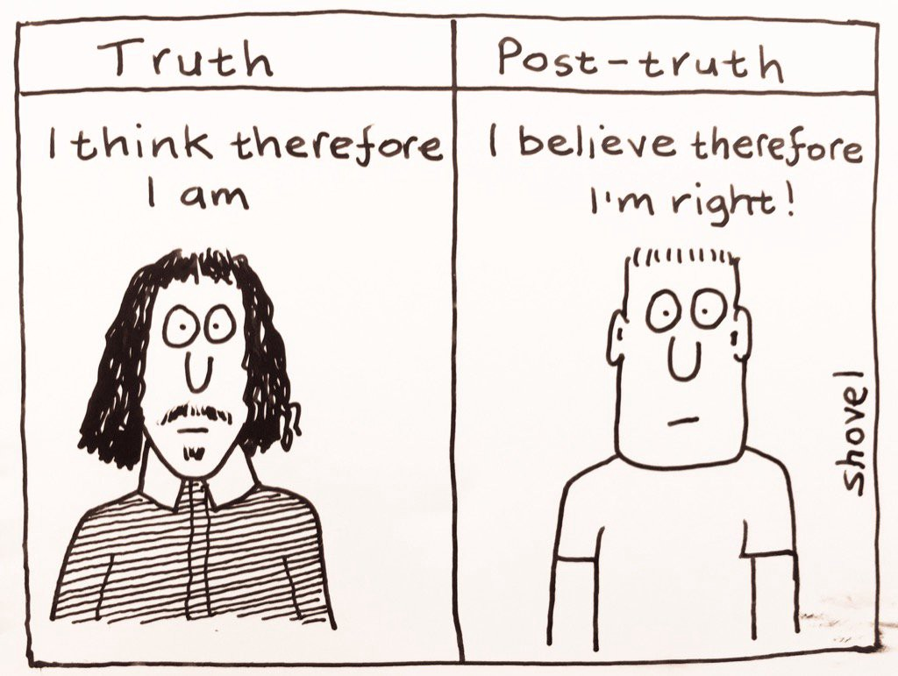

Slide 4
Four core questions
Part 1. What is truth?
Part 2. How we find (a version of) truth?
Part 3. How do we know how close it is to (a) truth?
Part 4. How do we describe that perspective on truth?

Slide 5
Format
Applied PANDA summaries – all you need
Capacity building
Stops for discussion
Slides shared
NIHR GSU training platform

Slide 6
Challenges
Limited examples in:
Surgery
LMICS
Reflexivity
Sharing perspectives
Learning journey
Today not about CEI, but informed by community partners

Slide 7
Past experiences

Slide 8
Part 1. What is truth?

Slide 9
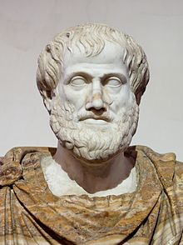
Philosophical perspectives
Ontology: what is the nature of the world (and the things in it)
Epistemology: how can we know the world?

Slide 10
Ontology
Does the world exist independently from human practice/ knowledge?
Does this mean that truth can be discovered?
Can the researcher be separate from the world?
Realism—a real world exists
Critical realism—a real world exists but our knowledge is always partial
Relativism—multiple constructed realities

Slide 11
Epistemology
How can we know about the world?
Is it possible to know ‘the truth’?
How is knowledge shaped?
Positivism (linked to realism)—truth is found by experiment; removal of bias
Constructionism (linked to relativism): focus on social construction of knowledge within context

Slide 12
Qualitative research
From gap in knowledge
To enriched understanding in context
Relativist / constructionist approach
No single truth
Often applied to ‘harder’ questions or ‘earlier’ questions
Can still be very high quality!
Applied PANDA summary

Slide 13
Question break 1

Slide 14
Part 2. How do we find (a) truth?

Slide 15
A shift in perspective…
? | Quantitative (deductive) | Qualitative (inductive)
What is the nature of reality? | A “real” world | “Multiple realities”
What can be known about it? | How things really are can be known or predicted | Only how things are understood or experienced can be known
What is the relationship between the ‘knower’ and ‘what can be known’? | Independent/objective | Inter-dependent/subjective
How would the ‘knower’ go about finding out whatever they believe can be known? | Testing hypotheses, controlling possible confounding factors | Discovering new meanings, considering “context”

Slide 16
What is qualitative research?
“Collection, analysis and interpretation of data that are not easily reduced to numbers.”
“All data relating to the social world and the concepts and behaviours of people within it.”

Slide 17
5 important components
Perspective of those studied
Description of setting
Understanding whole context
Focus on process and change
Flexible and less structured
Notes:
Give voice to the ‘underserved’
Understand what shapes people’s understandings, values and experiences
Understand ‘health’ as a social / cultural activity

Slide 18
Qualitative reasoning
Arrive at results from small number of individuals that may reflect a larger groups
Study of a range of individuals and find patterns
Form conceptual ‘themes’ (inductive approach)
what are people talking about?
what issues seem most important?

Slide 19
Inference
Abstract interpretation through inferential ‘leaps’
People think/ act like this because…
Must be supported by
Participants in ongoing research
Comparing with other literature
Wider theory, e.g. health beliefs
Summarise experiences
Themes
Interpretation
Inferences
Extrapolate
Check inferences
Further data
Further theories

Slide 20
Qualitative research design
Method (e.g. interviews)
Methodology
(e.g. theory)
Paradigm (e.g. world view)
Today we will work from outside to inside…

Slide 21
Choosing a methodology

Slide 22
Four dimensions of qualitative research
Phenomenology
Grounded Theory
Interpretive
Experiential
Critical
Thematic Analysis
Realistic Evaluation
Framework
Descriptive

Slide 23
Descriptive
Interpretative
“why did intervention x work/ fail?” / “what issues are important to patients?”
Prescribed questions/ themes, with room for emerging themes
Focused more on reporting content of responses
May quantify responses/ combine with quant. methods
Used in service evaluation, needs assessment, to gauge spectrum of opinions
“how do people experience chronic illness y?” / “what does taking meds mean to patients?”
Starting with topic of interest, gradually refining questions
Focused more on generating explanations/ theories
Numbers are unimportant, may use ‘a few’; ‘some’; ‘most’
Used to explore an unknown field; areas where meanings are important

Slide 24
Experiential
Critical
Focuses on ‘getting into the heads’ of participants
This can be direct (‘data speaks for itself’) or via a process of interpretation
Importance of understanding, people making sense of their experience
Meaning of experience (e.g. of illness) is deeply personal and unique to the individual
Some focus on ‘lifeworlds’ within which individual is situated
Focuses on ‘getting out into the world’ (which is social)
Needs to be contextualised within some form of social theory
Importance of language which is again shaped by social realities
Experience and its articulation is structured by social discourse and social roles
The lifeworld is always a social world!

Slide 25
Four dimensions of qualitative research
Phenomenology
Grounded Theory
Interpretive
Experiential
Critical
Thematic Analysis
Realistic Evaluation
Framework
Descriptive

Slide 26
PANDA methodology
Start with no data
Arrive at patients’ priorities
Generic, applied, pragmatic, inductive
Not governed by one of the ‘big five’ qualitative traditions
Thematic +/- framework analysis
Applied PANDA summary

Slide 27
Question break 2

Slide 28
Choosing a method

Slide 29
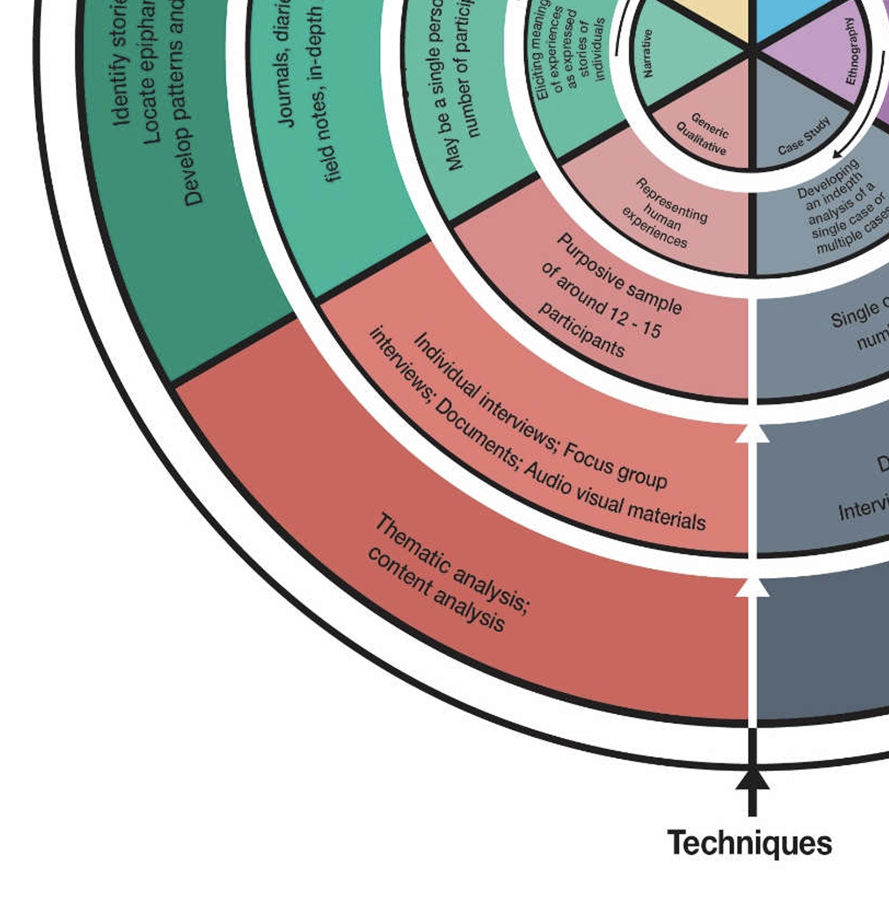
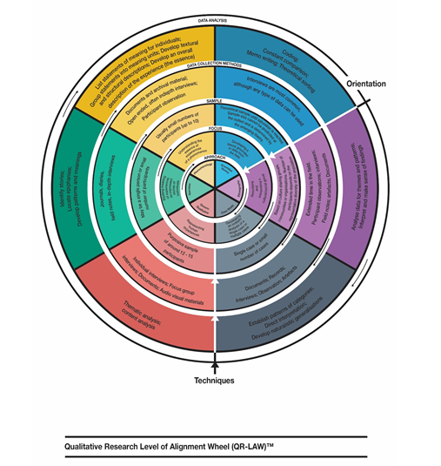
QR-LAW tool
= Alignment

Slide 30
Qualitative interviewing
‘Dig out information’
A conversation with a purpose
‘Explores unknown
territory
Notes:
Assumption that the participant possess specific information which the interviewer needs to ‘dig out’
Structured and semi-structured interviews
Generate fairly homogenous data
Traveller explores unknown territories and asks questions that lead participants to tell their own stories
Unstructured, depth, narrative interviews
Generate heterogeneous data

Slide 31
Sampling
Purposeful = looking for ‘information-rich’ participants
Purposeful = rationale to fit research question
Range of experiences
Building theory
Considerations
target population
inclusion criteria
budget/resources,
practicalities of data collection (e.g. length of interview)
recruitment
Information-rich cases are those from which one can learn a great deal about issues of central importance to the purpose of the inquiry.” Patton (2002)

Slide 32
Types of purposive sampling
Maximum variation sample
Convenience sample
Snowball sample
Theoretical sample
Notes:
Convenience sampling – lacks any sampling strategy, the researcher chooses the sample according to ease of access – may be suitable for hard-to-reach or invisible populations e.g. prostitutes, tax evaders, or individuals with a rare or stigmatised condition
Snowballing or opportunistic sampling is purposeful; the researcher must sample strategically

Slide 33
Sample size “Saturation”
The moment when collecting more data does not significantly add to main themes
Not a ‘qualitative sample size calculation’
Not when the researcher has ‘heard it all’
Enough data to inform abstract interpretation and allow illustration (quotes)
More complex = more data
Notes:
Informational redundancy

Slide 34
Think about:
‘What is said in relation to how, where, when, and by whom narratives are conveyed, and to what end’
Because:
‘The respondent as much assembles narratives of experience as he or she answers interview questions’
Active listening

Slide 35
Reflexivity
Think about the (power) dynamic between you and the interviewee.
How did your role, age, gender, ethnicity, environment influence answers
Is this something that you can / should change?
How will it influence the ‘truth’

Slide 36
A note on ethics
Power differences?
Sensitive topics are likely – risk of harm?
Who benefits from the research?
Being asked for ‘expert’ advice
Equity and diversity of participants
Equal voice
Confidentiality / anonymity

Slide 37
Minimising distress
Anticipate distress
Participant in charge of stop / pause/ continue with interview
Don’t be afraid of silences
Don’t be afraid to apologise & stop if you unintentionally go ‘too far’ or ‘get it wrong’
De-brief afterwards, if possible
Learn from experiences
re-phrase questions
change order of topics
ask permission

Slide 38
The topic guide
Outline of key topics and questions to cover
Pilot in first 2-3 interviews
Can reorder as needed
Not limited to topic guide
Take a note of helpful probes
Start with least sensitive topics
Do people respond?
Do people understand?
Are you getting enriched understanding?
Opposite of medical assessment (not a ‘funnel’!)

Slide 41
Common problems
Asking multiple questions at once
Asking leading questions
Not allowing silences
Being poorly prepared
Being over prepared
Trying to reassure the participant, rather than letting them express their emotions
Failing to probe further

Slide 42
After the interview…
Did I allow silences?
Did I pick up on cues?
Did I use appropriate probes?
Did I give the participant time and opportunity to develop ideas and to take the interview in their own directions?
How directive was I?
Did I think about subject positioning, power and ethics?
Was the interviewee comfortable?
Is there anyone else I can talk to?
Other researcher, translator?
Take notes!

Slide 43
Transcribing
Writing everything down…
Time consuming!
Content (easy) versus conversation (harder)
Unspoken
Translation issues
Support available @ UoB in English language

Slide 44
PANDA method
Semi-structured interviews (miner)
Maximum variety sampling
Aim 10-12 interviews
Patient + researcher delivery
Probes for depth + breadth
Topic guide (improve over time)
Key data
Transcriptions (?English)
Interview notes
Reflexivity diary
Applied PANDA summary

Slide 45
Question break 3

Slide 46
What do we do with all that data?

Slide 47
Coding
Labelling into units (codes, categories, themes)
Organising meaningfully
Searching for connections and patterns
Holistic and reflexive approach
Discovering what is important
Deciding what to tell the world

Slide 48
Coding
Sorting
Codes
Synthesizing
Categories
Themes
Theorizing
Theory
DESCRIPTIVE
INTERPRETIVE

Slide 49
What is a ‘theme’?
An analytical category that both “describes and explains social phenomena” (Mays and Pope, 2000)
A means of structuring the data: “Data within themes should cohere together meaningfully, while there should be clear and identifiable distinctions between themes.” (Braun and Clarke, 2006)
An abstract concept that “once identified, appears obvious … indicated by the data rather than concrete entities directly described by the participants” (Morse and Field, 1995)

Slide 50
Common to all
Subgroups
Individuals
Hospitals or relationships
Ways to interpret themes
Iterative approach
Constant comparison
Deviant/ Disconfirming cases
Illustrative quotes
Link to healthcare practice
Link to theory

Slide 51
PANDA analysis
Thematic content analysis
May use framework method
Keep comparing
Contradiction important
Reflexivity essential
Will use NVivo software (UoB license)
Applied PANDA summary

Slide 52
Question break 4

Slide 53
Part 3. How close is it to (a) truth?

Slide 54
Quality in qualitative research
Not the same as trials!
No ‘single truth’
Bias not relevant (deviation from single truth)
Q: How compelling are the reasons to accept ‘this’ version of the truth in context
Embraces and manages subjectivity

Slide 55
All about trustworthiness
Qualitative
Quantitative
Credibility
Transferability
Dependability
Confirmability
Internal validity
External validity (or generalisability)
Reliability
Objectivity

Slide 56
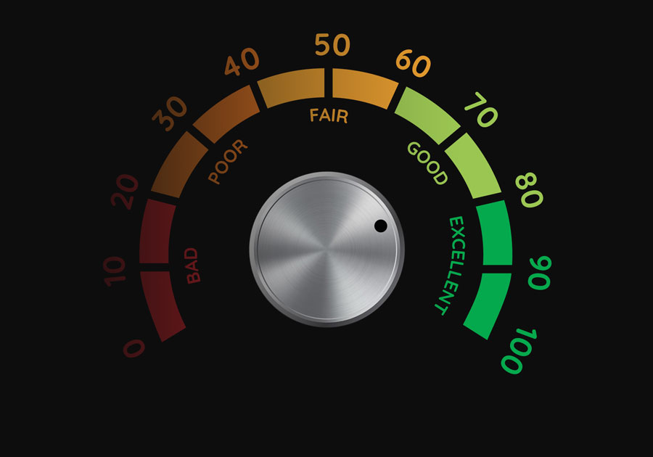
Credibility (Internal validity) | Prolonged engagement Persistent observation Triangulation Peer debriefing Negative case analysis Member checking
Transferability (external validity or generalisability) | Thick description
Dependability (reliability) | Linked to credibility Data saturation Double coding Audit (“inquiry audit” or audit trail)
Confirmability (objectivity) | Triangulation Audit (“inquiry audit” or audit trail)
All four criteria | Reflexive journal

Slide 57
Part 4. How do we describe that truth?

Slide 58
PANDA publication
No ‘%’ (except in patient features)
No ‘how many’
What, how and why we’ve come to patient priorities
‘Thick description’ – context ++
Illustrative quotes
One section per priority
Summary table / visual abstract

Slide 59
Qualitative publishing
COREQ checklist
Not as straightforward as CONSORT for trials
Few expert reviewers in specialty journals
Two things to ensure:
Descriptive, interpretative, theoretical validity
Alignment to a chosen methodology

Slide 60
Peer review Does the research, as reported, illuminate the subjective meaning, actions, and context of those being researched?’

Slide 61
Criteria 1
Evidence of responsiveness to social context and flexibility of design
‘Is there evidence of the adaption and responsiveness of the research design to the circumstances and issues of real-life social settings met during the course of the study?’
‘the hallmark of good qualitative research is its variability, rather than its standardisation’

Slide 62
Criteria 2
Evidence of theoretical or purposive sampling
‘Does the sample produce the type of knowledge necessary to understand the structures and processes within which the individuals or situations are located?’

Slide 63
Criteria 3
Evidence of adequate description
‘Is the description provided detailed enough to allow the researcher or reader to interpret the meaning and context of what is being researched?’
Think ‘thin’ and ‘thick’ description

Slide 64
Criteria 4
Evidence of data quality
‘How are different sources of knowledge about the same issue compared and contrasted?’
‘Are subjective perceptions and experiences treated as knowledge in their own right?’
Rendering transparent the processes by which the data have been collected, analyzed and presented (including considering the involvement of the researcher)

Slide 65
Criteria 5
Evidence of theoretical and conceptual adequacy
‘How does the research move from a descriptions of the data, through quotation or examples, to an analysis and interpretation of the meaning and significance of it?’ (constant comparison)

Slide 66
Criteria 6
Potential for assessing typicality
‘What claims are being made for the generalizability of the findings to either other bodies of knowledge or to other populations or groups?’

Slide 67
Question break 5

Slide 68
PANDA next steps
Takeaway and process – a lot!
Pilot in first 1-2 patients
Remember CEI major secondary aim
Team meeting
Language
Topic guide improvement
Emerging themes
Reflexivity
Applied PANDA summary

Slide 69
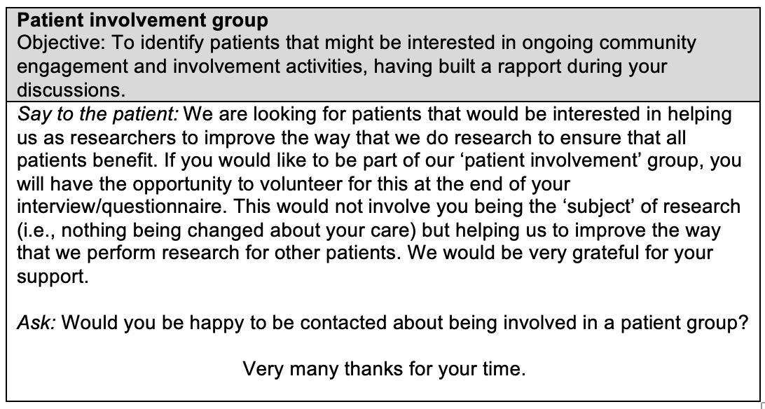

Slide 70
Qualitative research Care around the time of surgery in LMICs
PANDA project launch

Slide 71
Extra materials

Slide 72
Thematic analysis 1 (Braun & Clarke 2008)
6-step process of developing and refining themes described by Braun & Clarke from their experience of teaching qualitative analysis:
Familiarising yourself with your data
Generating initial codes
Searching for themes
Reviewing the themes
Defining and naming themes
Writing up your analysis

Slide 73
OSOP – A useful technique
The ‘OSOP’ method is a halfway house between constant comparison and summarising approaches
Aim to collate any issues that arise in a section of the interview on ‘One Sheet of Paper’ (each with an ID)
Example: PANDA
Relationship with surgical team and timing of surgery (ID1)
Timing of surgery and worry about cost of surgery (ID2)
Timing of surgery and communication with family (ID3)
You can then use this to develop broader themes

Slide 74
The Framework method (Ritchie & Lewis 2003, Gale 2013)
Develops a matrix to be able to compare across cases and within cases; however, risks reducing efforts for constant comparison
Themes in columns
Cases in rows
Useful for data management
Audit trail
Data reduction

Slide 75
Framework matrix: PANDA example
 | Themes
 | Costs of surgery | Family communication | Day-to-day challenges
Emergency, benign (ID1)
Elective, cancer (ID2)
Emergency, trauma (ID3)

Slide 76
CASP critical appraisal tool for qualitative research
Was there a clear statement of the aims of the research? | 2. Is a qualitative methodology appropriate? Is it worth continuing ....
3. Was the research design appropriate to address the aims of the research? | 4. Was the recruitment strategy appropriate to the aims of the research?
5. Was the data collected in a way that addressed the research issue? | 6. Has the relationship between researcher and participants been adequately considered?
7. Have ethical issues been taken into consideration? | 8. Was the data analysis sufficiently rigorous?
9. Is there a clear statement of findings? | 10. How valuable is the research?

